Slide 1


A Final Year Project Work Proposal Defense
On
MNIST based Handwritten Digit Recognition from Scratch
Presented By:
Biswas Poudyal(10526/073)
Krishna Khanal(10691/073)
Sameer Kattel(10713/073)
Subina Lama(10720/073)
March, 2020
Notes:
<number>

Slide 2
Presentation Outline
About Project Topic
Literature Review
Methodology
System Analysis
Project Scheduling Plan
Conclusion
References
Appendix
<number>

Slide 3
About Project Topic
Statement of Problem
Handwritten Digit Recognition , a challenge for computer
Lots of astonishing works have been done but many are based on high-level framework and libraries
This project aims to design a efficient model from scratch that can classify a handwritten digit as accurately as possible.
About Project
The project intends to implement a Feedforward Neural Network model from scratch, that will be able to recognize the handwritten digits.
<number>

Slide 4
About Project Topic
Objectives
To design a Multi-Layer FFNN Model that recognizes Handwritten digits (one at a time) with high accuracy.
To properly analyze and optimize the designed model using different model improvement techniques and optimization algorithms.
To implement the components of the project from scratch.
<number>

Slide 5
Literature Review
Classifier | Error Rate(%) | Reference
Linear classifier (1-layer NN) | 12 | LeCun et al. 1998 [1]
K-NN with non-linear deformation (P2DHMDM) | 0.52 | Keysers et al. 2007 [5]
Virtual SVM, deg-9 poly, 2-pixel jittered | 0.56 | DeCoste and Scholkopf, 2002 [6]
2-layer NN, 800 HU, cross-entropy [elastic distortions] | 0.7 | Simard et al. 2003 [2]
6-layer NN 784-2500-2000-1500-1000-500-10 (on GPU) [elastic distortions] | 0.35 | Ciresan et al. 2010 [4]
Convolutional net Boosted LeNet-4, [distortions] | 0.7 | LeCun et al. 1998 [1]
Committee of 35 conv. net, 1-20-P-40-P-150-10 [elastic distortions] | 0.23 | Ciresan et al. CVPR 2012 [7]
Convolutional net With DropConnect | 0.21 | LeCun et al. ICML 2013 [8]
<number>

Slide 6
Methodology
Resource Requirements
Hardware: PC with Multi core CPU
Software: Python Programming Language with Numpy, Matplotlib and Scipy as its core packages, Anaconda Navigator
Tools and Techniques
Design Tools: MS Visio ,MS Word 365
Implementation Tools: Jupyter Platform
<number>

Slide 7
Methodology
Project Understanding
2. Data Understanding
5. Model Evaluation
3. Data Preparation
4. Data Modeling
CPMAI Based Process Model
<number>

Slide 8
System Analysis
Functional Requirements
The model should be able to classify any new image of a handwritten digit with maximum accuracy.
The model should not classify any alphabets and characters as a digit.
<number>

Slide 9
System Analysis
Data Description
MNIST Database used.
The database was consists of four files in binary(idx) file format
Data after processing is split into Train/ Dev and test set
Dataset | Processed Array size | Original Array Size
Training Set Image | (784, 60000) | (60000, 28, 28)
Training Set Label | (11, 60000) | (1, 60000)
Dev Set Image | (784, 5000) | (5000, 28, 28)
Dev Set Label | (11, 5000) | (1, 10000)
Test Set Image | (784, 5000) | (5000, 28, 28)
Test Set Label | (11, 5000) | (1, 10000)
<number>

Slide 10
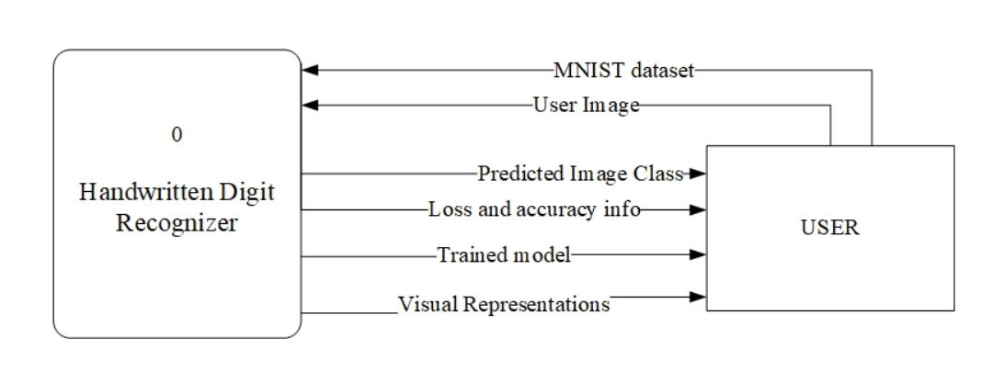
System Analysis
Process Modeling
Fig: Context Diagram
<number>

Slide 11
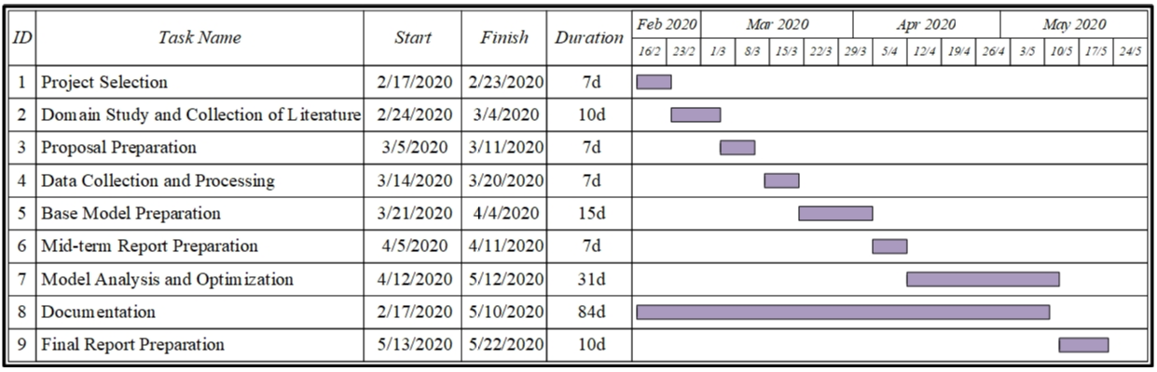
Project Scheduling Plan
Fig: Gantt Chart
<number>

Slide 12
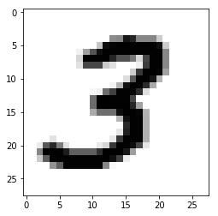
Conclusion
The final model should be able to classify any new image of a handwritten digit with maximum accuracy.
Actual Label: 3, Predicted Label: 3
<number>

Slide 13
References
Y. Lecun, L. Bottou, Y. Bengio and P. Haffner, "Gradient-based learning applied to document recognition," in Proceedings of the IEEE, vol. 86, no. 11, pp. 2278-2324, Nov. 1998.
P. Y. Simard, D. Steinkraus and J. C. Platt, "Best practices for convolutional neural networks applied to visual document analysis," Seventh International Conference on Document Analysis and Recognition, 2003. Proceedings., Edinburgh, UK, 2003, pp. 958-963
G. E. Hinton, S. Osindero and Y. Teh, "A Fast Learning Algorithm for Deep Belief Nets," in Neural Computation, vol. 18, no. 7, pp. 1527-1554, July 2006.
D. C. Ciresan, U. Meier, L. M. Gambardella, J. Schmidhuber, “Deep Big Simple Neural Nets Excel on Handwritten Digit Recognition.” in Neural Computation, vol. 22, no. 12, pp. 3207–3220, Dec 2010.
D. Keysers, T. Deselaers, C. Gollan and H. Ney, "Deformation Models for Image Recognition," in IEEE Transactions on Pattern Analysis and Machine Intelligence, vol. 29, no. 8, pp. 1422-1435, Aug. 2007.
D. Decoste, B. Schölkopf, “Training Invariant Support Vector Machines,” Machine Learning, 46, 161–190, 2002.
D. Ciresan, U. Meier and J. Schmidhuber, "Multi-column deep neural networks for image classification," 2012 IEEE Conference on Computer Vision and Pattern Recognition, Providence, RI, 2012, pp. 3642-3649.
L. Wan, M. D. Zeiler, S. Zhang, Y. LeCun, R. Fergus, “Regularization of Neural Networks using DropConnect,” ICML, 2013.
<number>

Slide 14
Appendix
Loop for n iterations
Initialize all Parameters
Linear Softmax Forward
L-1 Linear ReLU Forward
Forward Layer 1
Forward Layer L-1
Linear Forward
ReLU Forward
Linear Forward
ReLU Forward
Update Parameters
Compute Loss
L-1 Linear ReLU Backward
Linear Softmax Backward
Backward Layer 1
Backward Layer L-1
Linear Backward
ReLU Backward
Linear Backward
ReLU Backward
Feedforward Neural Network Model
Predict
<number>

